Slide 1
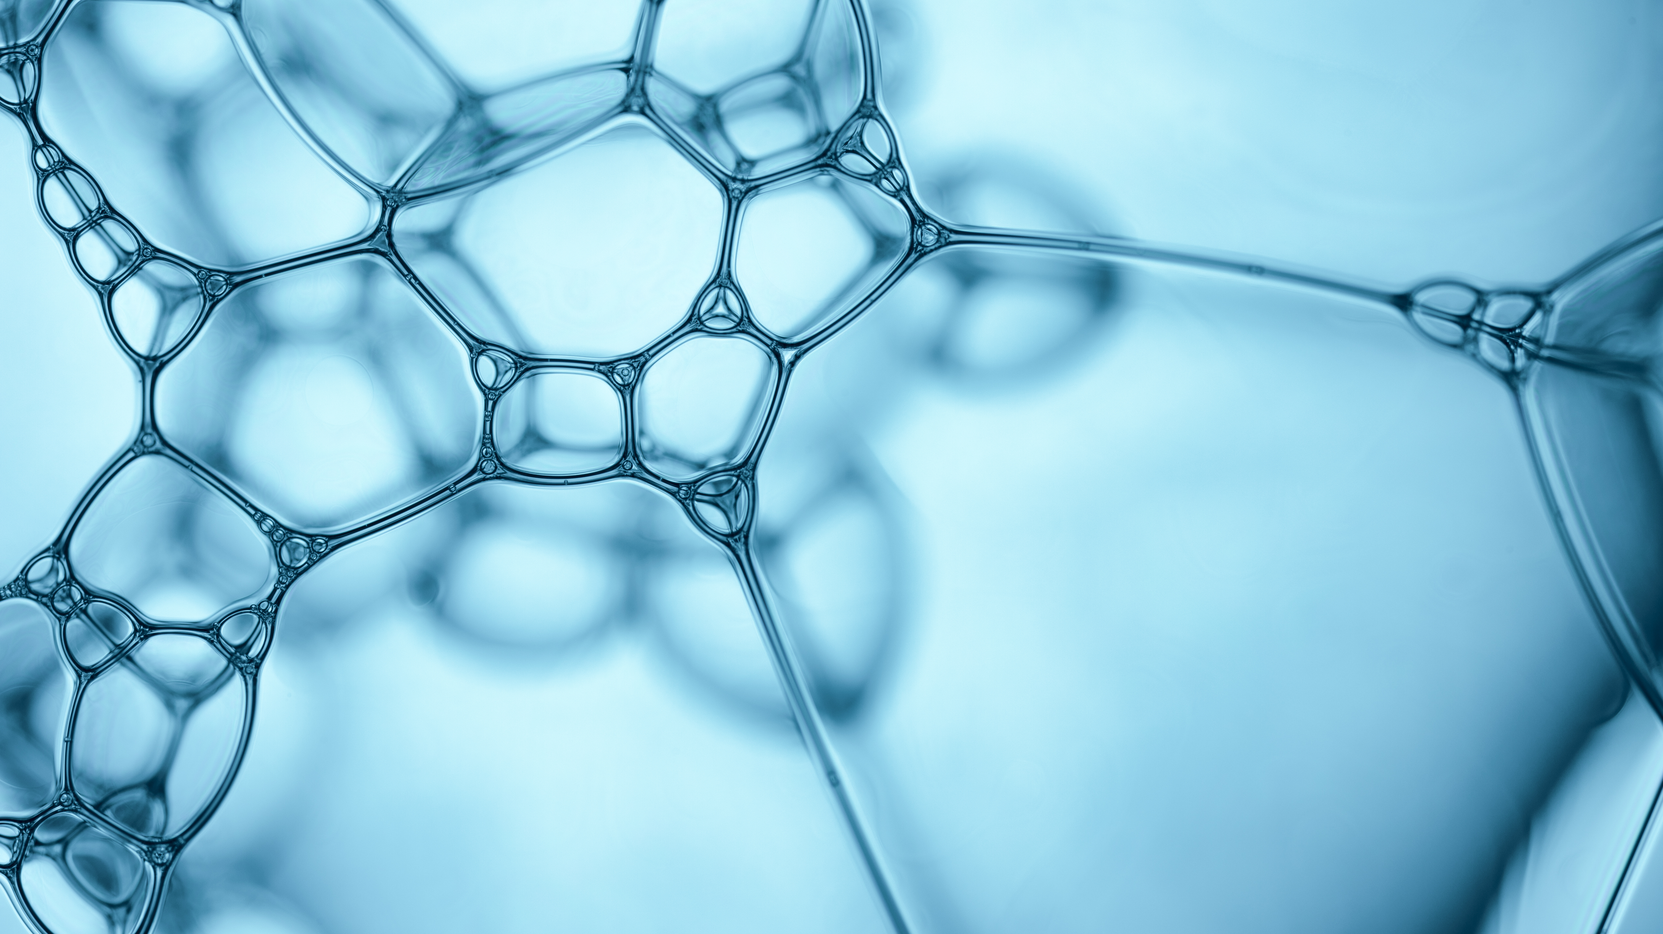
Respiratory System

Slide 2
Curriculum Point
The respiratory system is structured to facilitate the exchange of gases between the external environment and the blood

Slide 3
Structure
All cells in the body need oxygen for respiration and all cells need to remove the carbon dioxide that they produce.
In the lungs, oxygen is taken from air into the blood and the blood transports and takes it to the lungs where it is passed into the air.
The organs of the respiratory system include the nose, through which air is taken in; the trachea (windpipe), which branches into two tubes; the bronchi; and the two lungs.

Slide 4
The two lungs take up the whole chest cavity, expect for the space between them that is occupied by the heart and blood vessels.
Inside the lungs, the bronchi branch many times and eventually end in very fine tubes called bronchioles.
The smallest bronchioles open into clusters of tiny air sacs called alveoli. It is the alveoli that are the exchange surface for respiratory gases.
Each alveolus is surrounded by a network of blood capillaries.

Slide 5
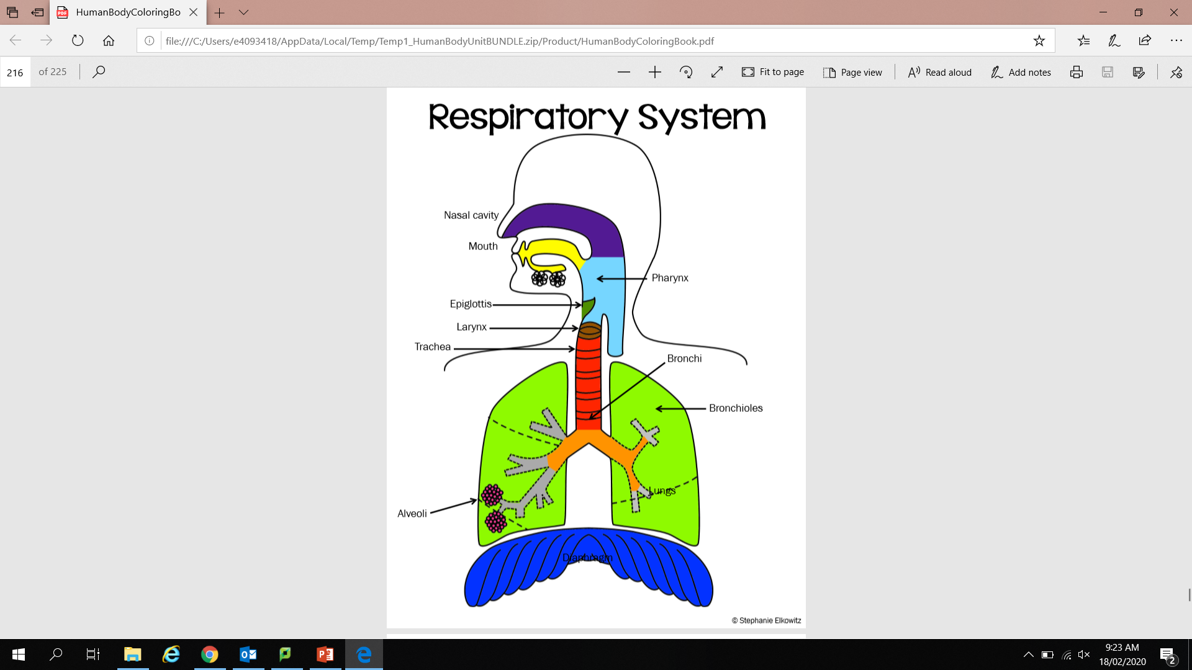

Slide 6
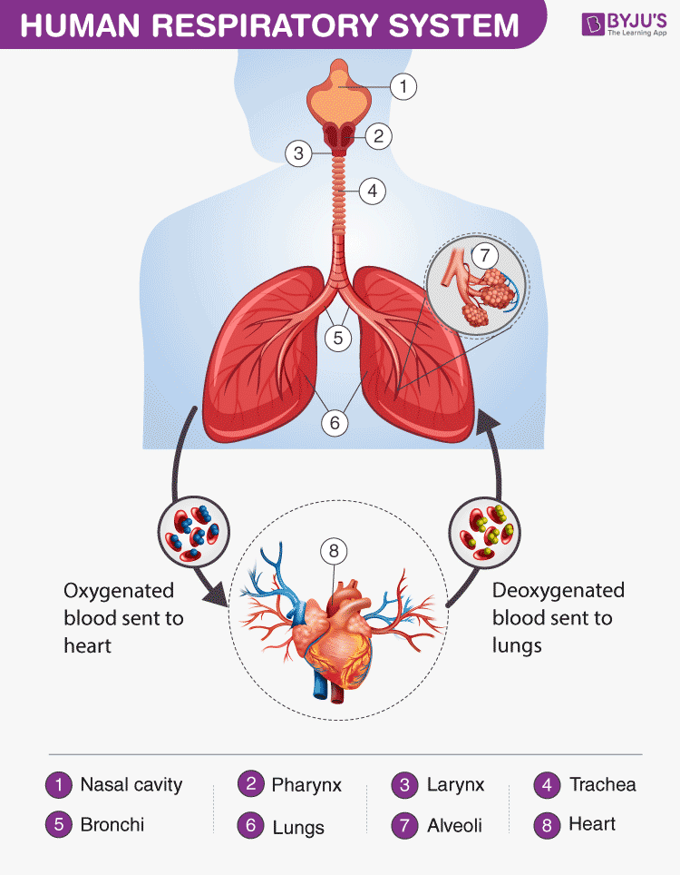

Slide 7
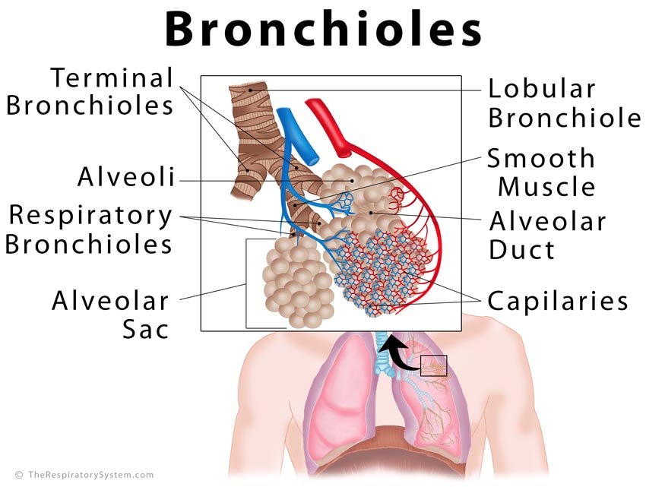

Slide 8
The blood in capillaries surrounding the alveoli is brought to the lungs by the pulmonary arteries.
This blood has been through the capillaries of the body, where much of the oxygen has been taken up by the body cells.
The blood that comes into the capillaries around the alveoli has a low concentration of oxygen- lower than the concentration in the air in the alveolus.
Oxygen therefore dissolves in the moisture on the inside of the alveolus and diffuses through the membrane, through the walls of the capillaries and into the blood.

Slide 9
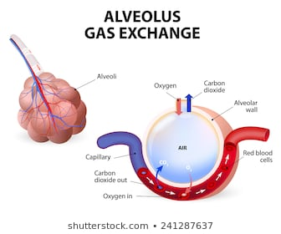

Slide 10
The blood arriving at the capillaries of the alveoli has a higher concentration where it has picked up carbon dioxide.
It has come from the body circulation where it has picked up carbon dioxide produced by respiration in the cells.
The concentration of carbon dioxide in the alveolar capillaries is therefore higher than the concentration in the air in the alveolus.
Carbon dioxide diffused out of the blood, into the air in the alveolus.
Expire air contains less oxygen, and more carbon dioxide, than inspired air.

Slide 11
For diffusion of gases into and out of the blood, there must be a concentration gradient- that is, a difference in gas concentration between the air in the alveoli and the blood in the capillaries. The concentration gradient for oxygen and carbon dioxide is maintained by:
  The constant flow of blood through the capillaries.
  The movement of air into and out of the alveoli as we breathe in and out.

Slide 12
Curriculum Point
To be efficient, gas exchange surfaces have to have the following characteristics:
large surface area
thin
moist
vascular

Slide 13
Large Surface Area
The alveoli give the lungs a huge internal surface, so that large amounts of gases can be exchanged in a relatively short time. Estimates of the number of alveoli in the lungs vary considerably but there are hundreds of millions of them; they probably have a total surface area of 50-80m ².

Slide 14
Thin
The membrane that forms the wall of the alveolus is very thin, so that gas molecules do not have far to travel when moving into or out of the blood. The wall has only one layer of cells and is only 1 micrometre thick.

Slide 15
Moist
The lungs are positioned deep inside the body to prevent excessive evaporation of the fluid that covers the respiratory surfaces. It is important that the membrane of the alveolus be covered by a thin layer of moisture because gases can diffuse into and out of the blood only when they are dissolved in fluid.

Slide 16
Vascular
Each alveolus is well supplied with blood vessels, so that as much blood as possible is close to the air in the alveolus. The continuous flow of blood helps to maintain a difference in concentration of oxygen and carbon dioxide in the blood and in the airs in the lungs.

Slide 17
Lung Volume
The lung volume can be changed by movements of the respiratory muscles, so that air is made to flow into and out of the lungs. Constant changing of the air in the alveoli helps to ensure that there is always a difference in the concentrations of oxygen and carbon dioxide in the air and in the blood.

Slide 18
Curriculum Point
The mechanics of breathing help to maintain the efficient exchange of gases in the lungs

Slide 19
Mechanics
For the efficient exchange of gases between the blood and the air in the alveoli, the air in the lungs must continually change. The process by which air is moved into and out if the lungs is called ventilation, or breathing. Air flows from places of higher pressure to places of lower pressure; thus air flows into and out of the lungs due to differences in air pressure.

Slide 20
Inspiration
The process of taking air into the lungs is called inspiration, or inhalation.
For air to flow into the lungs, the pressure of air in the lungs must be less than the atmospheric pressure outside the body.
Decreasing the pressure of air in the lungs is achieved by increasing the volume of the lungs.
To increase the volume of the lungs, the diaphragm and external intercostal muscles contract.

Slide 21
Inspiration continued.
The diaphragm thus becomes flatter and the rib cage moves upwards and outwards, increasing the volume of the chest cavity.
Increased lung volume means that the air pressure inside the lungs is slightly lower than the pressure outside.
Air flows in through the nose and trachea until the pressure becomes equal.
During normal, quiet breathing, the diaphragm is mainly responsible for the changes in chest volume.
Movements of the rib cage become more important during heavier breathing.

Slide 22
Expiration
Breathing out is called expiration, or exhalation.
It occurs in the opposite way to inspiration. The diaphragm and external intercostal muscles relax, so the diaphragm bulges more into the chest cavity and the rib cage moves downwards.
This reduces the volume of the chest cavity and, hence, that of the lungs.
Air pressure in the lungs is now greater than pressure outside the body.

Slide 23
Expiration continued
Air flows out through the trachea and nose until the pressures are equal.
When a person is breathing quietly at rest, expiration is a passive process, involving relaxation of the muscles that have contracted during inspiration.
Heavier breathing involves relaxation of the muscles that have contracted during inspiration.
Heavier breathing involves more forceful expiration, and the intercostal muscles contract to actively lower the rib cage.
The same sort of contraction occurs when forcibly exhaling, as when blowing up a balloon.

Slide 24
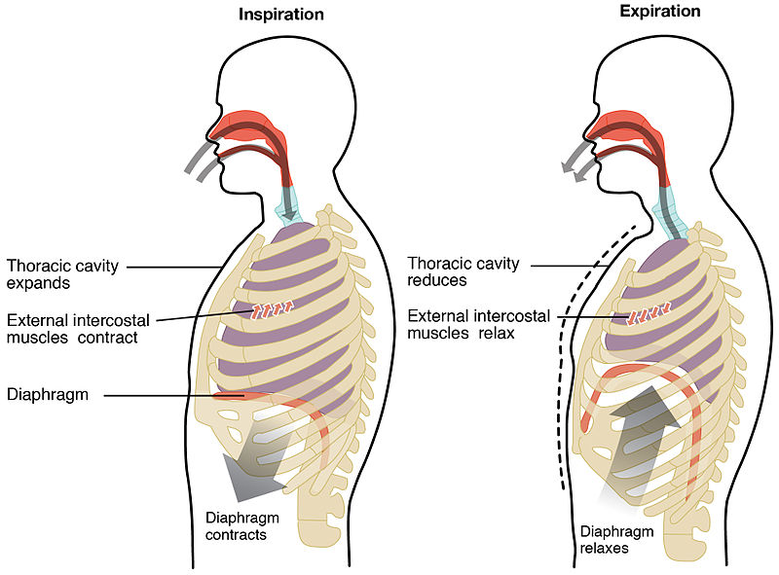

Slide 25
Curriculum Point
The function of the respiratory system can be compromised by diseases and conditions that reduce the efficiency of gas exchange

Slide 26
Emphysema
Emphysema is a disease usually caused by long- term exposure to irritating particles in the air taken into the lungs.
No one can avoid inhaling particle, as they are in the air. It is the amount that differs.
Smokers constantly inhale irritants in tobacco smoke as well as people who work in construction.
The irritating particles cause damage to the alveoli.
They lose their elasticity, are often replaced with fibrous tissue, and may break down, reducing the internal surface area of the lung.

Slide 27
Emphysema continued.
Because of the loss of elasticity of the lung tissue, the lungs are constantly inflated, and breathing out no longer occurs passively but requires voluntary effort.
Thus, the emphysema sufferer has two problems- inadequate surface area for gas exchange, and difficulty in ventilating the lungs.
Emphysema cannot be cured, and once lung damage begins, the progression of the disease cannot be stopped.

Slide 28
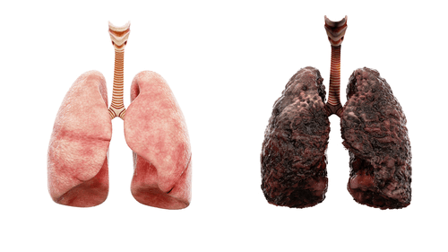

Slide 29
Lung Cancer
Involves the development of a tumour, a mass of cells that divides in an uncontrollable way. Evidence shows clear links between lung cancer and tobacco smoking, and exposure to asbestos fibres and other pollutants.
Tobacco smoke contains both initiators and promoters of lung cancer.
The most common form of lung cancer begins in the walls of the air passages, bronchi. The inhaled smoke particles irritate the mucous membrane, causing excessive mucous production, causing smokers cough.
Trapped mucous can rupture the alveoli and from that emphysema develops as a the cancerous growth develops in the air passage and spreads.

Slide 30
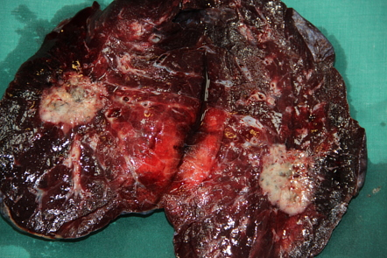

Slide 31
Lung Cancer
Pneumonia is an infection of the lungs caused by bacteria, viruses, fungi or other organisms.
The inflammation resulting from the infection causes secretion of fluid and mucus into the alveoli, thus reducing the amount of air that they can contain.
The surface area available for exchange of gases is also reduced, and breathing difficulty is common.
Tuberculosis is an infection, usually by the lung, by the bacterium Myobacterium tuberculosis.
Most lung infections, such as tuberculosis and pneumonia, are spread by droplets. Good hygiene practices help to reduce the spread of infections.

Slide 32
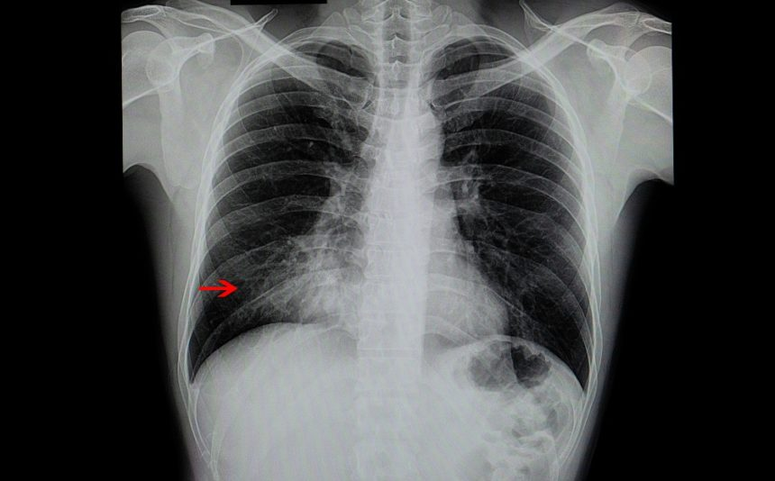

Slide 33
Asthma
An allergic response to foreign substances that enter the body.
During an attack, the muscles that surround the bronchioles go into spasm- sudden involuntary contractions. This causes narrowing of the air passages and difficulty breathing.
Using the irritation of the membranes lining the air passages causes secretion of excessive mucus and this also restricts movement of air. The reduced volume of air going into and out of the lungs means that the exchange of gases is impaired and the blood does not carry the usual amount of oxygen.

Slide 34
